Slide 1

Event leadership theory and practice for Event management and event tourism
Dr Emma Abson

Slide 2

Instructor lecture slides
These are the instructor’s lecture slides produced to accompany the book Event Leadership – theory and practice for event management and event tourism, by Emma Abson (with chapter contributions by Miriam Firth and Jane Tattersall), 2021, published by Goodfellow Publishers Ltd. These lecture slides accompanying illustrations are provided by the authors for the private use of instructors using the book Event Leadership. All the diagrams are copyright protected and should not be circulated beyond the classroom. To further support instructors, there is a set of PowerPoint slides for each lecture available.

Slide 3
Lecture 9 – modelling events as social agents of change

Slide 4

Lecture 9 – modelling events as social agents of change
Image: https://unsplash.com/@rossf

Slide 5
Lecture 9 learning outcomes
Define Social Agents of Change,
Understand how events produce a stage of information and education to lead and inform society,
Analyse how events mirror societal attitudes and behaviours,
Explore motivations and outcomes for leaderless events,
Identify how economies driving Events management lead to new employment practices.
Notes:
This lecture is a bit of a departure, and requires the students to think about the power of events to create changes in society. The hope is that it will wrap up the review of leadership, and challenge them to think about events in a new light.

Slide 6
Events as social agents of change
Stage
Leaderless
Employment
Mirror
Figure 9.1: A Model of Events as Social Agents of Change

Slide 7
Social agents of change – a definition
Social Agents of Change: A Definition
A social agent of change (SAC) can be a person, group or outcome from a range of activities. They are signalled as the start, or leader, in changing existing phenomena. Social agents of change as a term is rooted in Sociology theory as they evidence a change in existing social practices, scaled according to the issue actioned. Although the origins of the term have been linked to University students in Canada in the 1960s (see Lemon 2004) in contemporary practice SACs can be seen in Businesses and Individuals.
Notes:
An excellent example of organisations set up to change existing phenomena is ‘Grind out hunger’. Grind out Hunger are a not for profit organisation whose mission is to empower youth to take leadership in the fight against childhood hunger and malnutrition, through their passions of skateboarding, surfing, snowboarding and music to. SACs are not always one action or person but can be a combined effort by groups of people to change societal issues. An SAC is not always created to lead in societal change though. Film and media, for example, can serve to question the status quo in society to enable viewers to consider ways in which society act and behave (Bapis 2014). Other examples of SAC use is noted in linguistics (Charity 2008), mobile phone use (Nurallah 2009) and migrant participation in society (Burgess 2004; Grabowska et al. 2016). Therefore, although SACs are noted as a singular term, they are present in a wide range of businesses, individuals, media production, communication forms and members of society. If you raised money for a charity, you are also a SAC as you are raising awareness of the charity and signalling support is required for the Charity’s cause

Slide 8
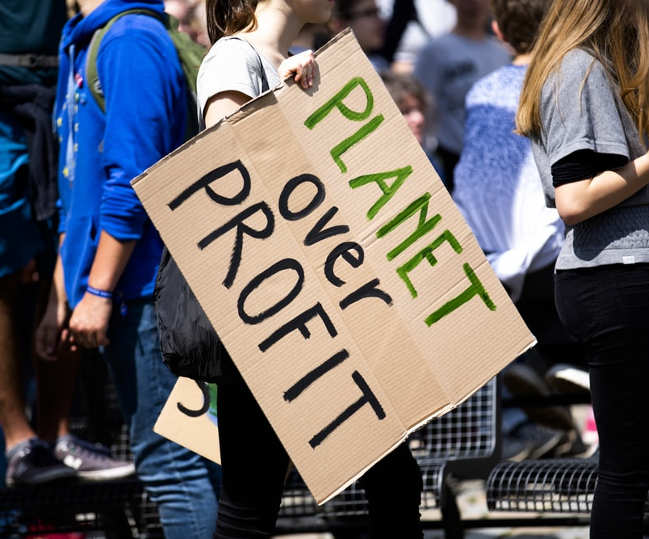
What are the global issues that SACs champion and try to change?
Climate change
Sustainability
Racial equality
Gender equality
Healthcare issues
Fair trade
Inclusion
Education for all
Image: https://unsplash.com/@markusspiske
Notes:
You can use the below, but it would be more appropriate to use current literature / news stories to ensure that you are covering relevant material. You can expand on these points, and discuss their relevance with the students.
Some of the common issues addressed by SACs include climate change, sustainability, gender equality, racial equality, healthcare issues, fair trade and inclusion. The issues may be specific geographic scales also: local, regional, national or international. The change does not have to be global to have an effect and the issue it champions can relate to a small area or group of people.
Probably the most widely known global issue championed by SACs is that of Climate Change and the Sustainability of our Planet. This is a known issue across the world and has been highlighted most recently by the work of Greta Thunberg (a clear SAC). Greta’s medical history coupled with her environmental activism is a story which has had a global impact. From school strikes to protests, her activism work has increased discussion on climate issues in many world nations. This is an interesting example of an SAC as the issue is not new, but through the SAC the issue has been brought to the public’s attention and enabled wider debate and consideration of the ways to reduce our impact on the natural environment.

Slide 9
Events as social agents of change
Sharpe (2007) identified how small scale music festivals can be SACs through mixing music with political agendas and ideas. For any avid festival attendee the political link is well known and seen. Festivals enable gatherings of large groups of people to share, experience and learn from each other and political groups are often seen within these promoting and sharing their policies and agendas with the public in attendance. SACs using events for political issues are also often seen in marches, protests or movements. The protests against Brexit, #blacklivesmatter marches and Greta’s school strikes are three such examples already noted in this chapter. Shapre’s (2007) discussion of a political music festival is interesting and can certainly confirm an event as an SAC. More often though events are used as SACs in leaderless events for protests, marches or strikes.
Consider – Notting Hill Carnival
Notes:
Use the following to discuss with the students how events can bring about change. You can prompt them to give examples of events they have attended / read about which have changed their own views.
In terms of understanding or positioning events as SACs, this is a relatively new, and sometimes contested link. Historically events are seen to be created through the heritage of local traditions and celebrations (Getz, 1990 and 2013) which have then led to larger scale profitable event businesses. St Patricks Day and Notting Hill Carnival are two such examples of when a local tradition grows to become a significant economic contributor both locally and internationally. However, from discussion in this chapter it is clear that almost every SAC will require events in order to gather people together to discuss and raise awareness of the issues and changes they want within the society. It is, therefore, clear that SACs depend upon events to ensure citizens can actively participate in understanding the issues at hand.

Slide 10
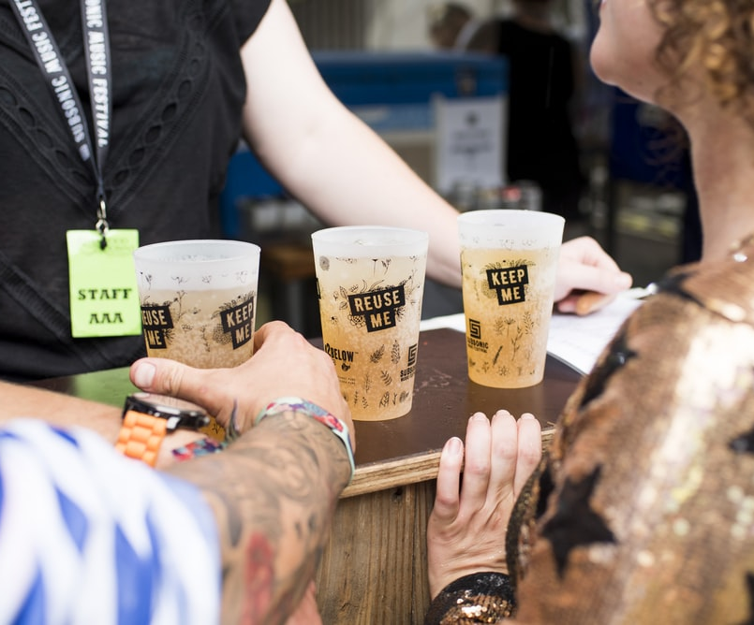
1. Events are a stage
Discussing some of the (very) limited literature linking events and events management to SACs is it clear that they can provide a stage for social learning and change, they can mirror society leading to socially responsible action, and can challenge political ideals in leaderless events.
Discuss – Events as Thought Leaders
Discuss - Education & Training through events
Image: https://unsplash.com/@globelet
Notes:
Earlier discussion on Events as SACs outlined how an event can be seen as a stage to present or address issues to event attendees. Whether this is cultural awareness (as a tourist) or learning about political agendas (at music and politics festivals), event attendees are presented with information and experiences which can lead to changes in society. For example, the ‘One World, Together at Home’ event of 2020/1 was a music event which praised the work of healthcare professionals working through the COVID19 pandemic, whilst educating the attendees to act as ‘Global Citizens’ and complete 15 actions to support stopping the spread of the virus. This event was requested by the United Nations (UN) and World Health Organisation (WHO) so that attendees could both celebrate through music and actively support the public during a global pandemic. Attendees were not required to visit a venue, but were actively encouraged to stay at home and enjoy music from leading artists across the world. Similar to the ‘Live Aid’ concert of 1985 the ‘One World: Together at Home’ event is an SAC to support contemporary society issues.

Slide 11
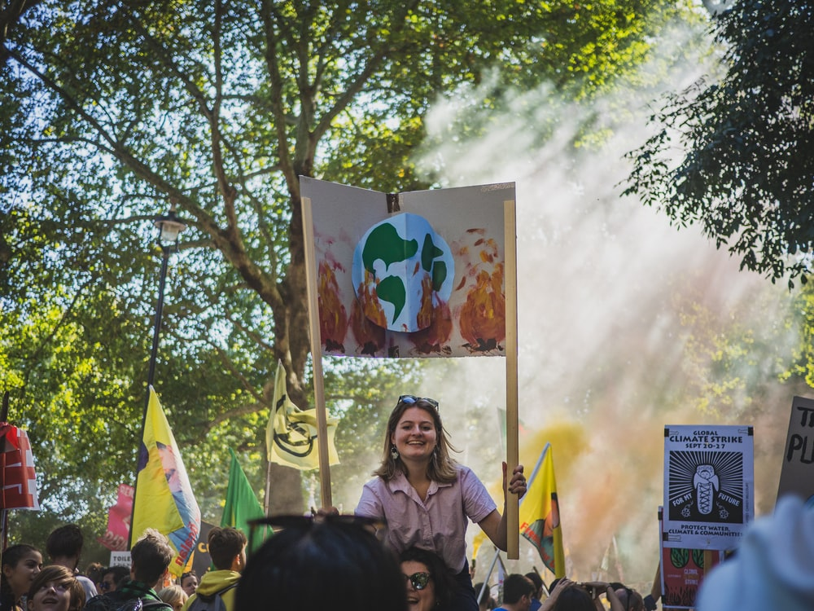
2. Events are a mirror
Events were traditionally created to support local and personal celebrations around societal frameworks (such as birthdays or marriages). National holiday celebrations are also present in most countries whereby historic events are remembered (such as Thanks Giving).
As such, events are created, accessed and attended by most communities across the world. With this background framework to events management, it is noted that events can be seen as miniature communities, or Petri dishes, of society from which you can analyse human behaviour. In conjunction, events can also lead to societal changes in behaviour if they educate and require different behaviours.
Image: https://unsplash.com/@gabrielmccallin
Notes:
SAC are notable when event attendee behaviour is undesirable and later action seeks to alter this, and also event engagement leads to changes in attendee behaviour after the event. Poor behaviour and promotion of new behaviours through events are now discussed to evidence how events as mirrors of society can lead to social change.
Poor human behaviour example
This position is most notable within festival attendee behaviour and the disposal of waste and possessions on site. From a 3-year on-site study completed at the UK's Glastonbury Festival to support their ‘Love the Farm, Leave no Trace’ campaign (Glastonbury Festivals 2020) management sought to correct poor attendee behaviour concerning waste management. This campaign was created to support the reduction of waste and the overall negative impact of attendee behaviour on the festival site. With over 200,000 attendees, this festival is a mega-event which produces a mega amount of waste. When completing exit surveys with attendees at this festival in 2015 several people were noting that they had taken their tent and possessions away and not littered, and yet they were not carrying anything on their departure. They knew that they should not litter, reported this in the survey, and yet did not act or behave in a way which represented this. It was clear they had a social conscience on appropriate behaviour and treating the site correctly, but for whatever reason, they did not all act in the appropriate way when on site. This position is confirmed in Musgrave and Henderson’s publications also and they note that understanding on and offsite attendee behaviour is important to ensure events are sustainable and attendees treat their local environments appropriately at all times (Musgrave 2011; Henderson and Musgrave 2014; Musgrave and Henderson 2015).
Promotion of new human behaviours example
Event Campaigns and new event concepts can lead to changes in attendee behaviours during and after events. The Love the Farm, Leave no Trace campaign at Glastonbury festival has raised awareness of attendee behaviour and has led to an increase in reusing materials, reducing waste and respecting the local environment (Glastonbury Festivals 2020). Strafford et al. (2018) noted how pop-up shopping centre events create enlivenment and add to usual shopping experiences. Instead of solely completing shopping and eating activities in a shopping centre, or mall, customers can immerse themselves in additional events which can lengthen their commercial experiences. Product displays, food samples, demonstrations, and leafleting local causes are all examples of how these retail events can lead to altered human behaviours. The Affordable Art Fair in Singapore offers an event where more people have access and opportunity to purchase art, as this is seen as too expensive for the majority of the local population. Educational events will also lead to altered attendee behaviours as they will gain knowledge to consider alternative ways of acting and behaving.

Slide 12
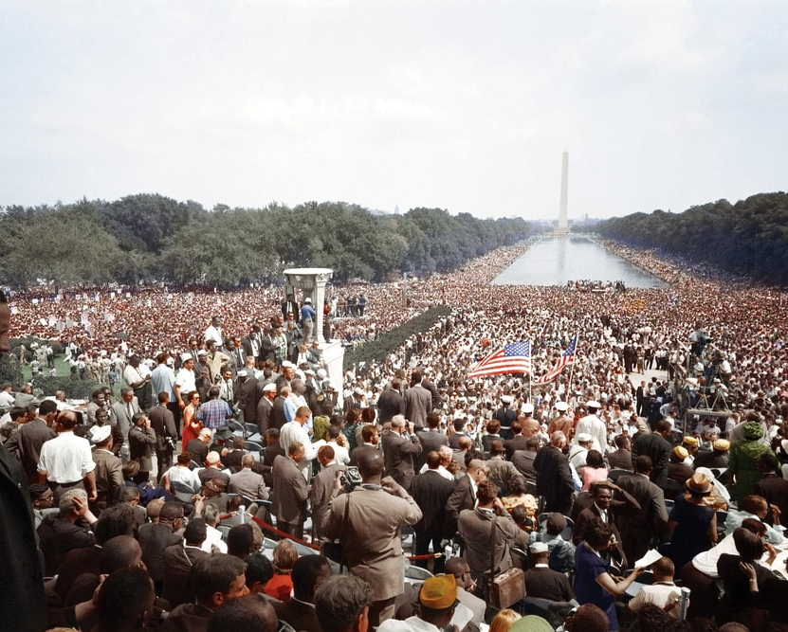
3. Events can be leaderless
When an Event is created and led by a society’s needs, rather than a small group of individuals or businesses objectives, it can create mobilised groups of society to act and challenge societal issues. Whether or not there is a singular leader in these events is contested. In essence, they are created due to a spontaneous societal problem perceived with the state, government, or society. As such, these events are usually seen in the form of protests, movements or demonstrations
Image: https://unsplash.com/@unseenhistories
Notes:
Examples of historical Leaderless events are noted below with comments on how they attribute to the model on SACs:
Gandhi's Salt March (India, the 1930s)
This demonstration of civil disobedience required thousands of activists across India acting against national laws. They demanded sovereign rule from the British and that the British rule in India was only due to the consent of Indian communities. Although this event did not lead to an immediate change in Indian rule, the campaign and marches enabled Indian people to confirm their civil rights requirements in solidarity across a nation.
South Africa's National Day of Protest (1950)
On 26th June 1950 over 500 delegates and 10,000 people attended events to protest the Suppression of Communism Bill in South Africa. This event and rally was part of a building series of protests called the Defiance Campaign based in South Africa. This campaign was tackling apartheid laws which sought to segregate citizens according to their race.
The March on Washington (the USA, 1963)
This march was to protest and demand civic and economic rights for African Americans living in America. The march only lasted 3 hours, but it was preceded with years of meetings to establish clear demands in the political and economic change needed. Over 250,000 people attended the march and it resulted in pressuring the administration into a new civil rights bill in congress.
Gandi (India), Nelson Mandela (South Africa) and Martin Luther King (Washington) are famous figures involved in the above case examples of leaderless events. Although they are linked and signalled as important leaders within the movements, they were not the leaders of the events. They aided in creating a national movement against existing political restrictions within the countries and resulted in positive outcomes for citizens living in the countries. A further example of contemporary Leaderless events are the Brexit marches and protests completed across the United Kingdom. It will take some years to note how these affect political change, but they too signal social unrest in political change.

Slide 13
4. Events lead to new employment practices
Winning contracts to produce major sporting events, like the Olympics, or being the host to world-leading events signals and leads to increased skills and knowledge production within a society
Events management often requires temporary or fixed-term contracts (Firth 2020). As such, Events employees do not complete traditional forms of contracted work, but will often have portfolio careers (defined in Greenspan 2017).
This change has not come from a perceived societal issue but is emergent due to the increase in the Events sector working environments which are often temporary and sporadic (Abson 2017).
The same can be noted in home based working as a result of the Global Pandemic from COVID19. There is a resulting change in employment practice due to a shift in economic and political frames surrounding the work which may lead to altered working practices.
Notes:
Events are often noted for their positive economic impact (Winkle et al. 2016; Getz and Page 2016). Since their significant growth in western economies in the last 50 years Events are seen as a core form of Tourism and Leisure activity supporting Gross National Outputs. Winning contracts to produce major sporting events, like the Olympics, or being the host to world-leading events signals and leads to increased skills and knowledge production within a society (Growth 2009). In tandem with the growth of the Events Industry, it is clear that new employment practices are emerging. Employment practices are said to need alteration to support environmental concerns (Musgrave, 2008) but there is also evidence that the growth in Events has also led to altered and improved employment practices.
Events management often requires temporary or fixed-term contracts (Firth 2020). As such, Events employees do not complete traditional forms of contracted work, but will often have portfolio careers (defined in Greenspan 2017). This change has not come from a perceived societal issue but is emergent due to the increase in the Events sector working environments which are often temporary and sporadic (Abson 2017). When reviewing the top Event Management companies and managers, there are common themes: innovation, creativity, socially inclusive and active social change (environmental, sustainably and employment).

Slide 14
Summary
This lecture has offered a Model of Events as Social Agents of Change. Through the definition of Social Agents of Change it is clear these have the power to lead change in society and improve conditions and practices. They may be individuals or businesses, but they all lead to a change in societal action and behaviour.
The model presented on Events as Social Change agents included four elements –
  Events are a stage
  Events are a mirror
  Events can be leaderless
  Events can create new employment practices

